Slide 1
Zomato
Restaurant
Analysis
By :- Jayesh Kharate
Batch :- May 2024

Slide 2
INTRODUCTION :
Zomato is a food based service industry helping
people to locate , order and dine in in restaurants.
The objective of this project is to
Analyse the existing data on food industry
Draw insights from it for current trends and sentiment of food
industry.
Understand the trends and look for opportunities for
investment in market and opening new restaurants

Slide 3
INTRODUCTION AND OBJECTIVES :
Objectives:
Identify potential countries and cities for opening new restaurants.
Analyze key factors influencing restaurant success, including competition
ratings, and cuisine preferences.
Introduction :
In a dynamic market, strategic expansion is crucial for sustained growth. This analysis delves into comprehensive data to pinpoint optimal locations, understand market trends, and provide actionable insights for informed decision-making.
Key Components:
Objective assessment of countries and cities for new restaurant openings.
In-depth analysis of factors impacting restaurant success.
Recommendations rooted in data-driven insights

Slide 4
STORYLINE
Step 1: Setting the Mission In Zomato's bustling headquarters, I am handed a massive dataset containing insights about restaurants from around the world. My mission is clear: Identify the best countries and cities for expansion. Understand customer preferences and trends. Provide actionable strategies for business growth.
Step 2: Cleaning the Data The raw dataset contains inconsistencies and missing values. To prepare for analysis, I:Fill Missing Values: Particularly for cuisines in certain locations, using logical replacements. Reformat Dates: Standardize date formats for easier sorting and analysis. Example Formula: =DATEVALUE(SUBSTITUTE(W2, "_", "-"))Add New Columns: Extract Day, Month, and Year from date fields to gain time-based insights. Currency Conversion: Convert all foreign currencies into INR for uniformity.

Slide 5
Step 3: Understanding the Landscape With the data cleaned, I analyze the following:
Total Restaurants: Count the number of restaurants in each country using pivot tables.
Price Ranges: Understand how restaurants are distributed across price brackets.
Online Delivery and Table Booking Trends: Examine the impact of these services on ratings and popularity.
Step 4: Identifying Opportunities To pinpoint expansion areas, I:
Use pivot tables to calculate:
Average restaurant ratings in each country.
Number of restaurants in cities with low competition.
Highlight 59 cities with fewer than 10 restaurants as potential growth zones.
Shortlist countries like Australia, Brazil, Canada, Singapore, and Sri Lanka for expansion based on:
Lesser competition.
Average ratings between 3 and 4.

Slide 6
Step 5: Recommending Strategies With the shortlisted locations in hand, I create actionable strategies:
Local Cuisine Focus: Start with authentic local dishes to build trust and appeal to local tastes.
Competitive Pricing: Develop tiered menus based on the average expenditure in each country.
Example: Average expenditure in Singapore is ₹9,944.18, whereas in Sri Lanka, it is ₹682.24.
Strategic Locations: Target cities with lower ratings and competition, such as Colombo and Yorkton, for a stronger market foothold.
Step 6: Visualizing Insights To ensure my findings are clear, I:
Create visualizations such as:
Bar Graphs: Number of restaurants opened each year.
Pie Charts: Distribution of restaurants by service availability (online delivery, table booking).
Line Charts: Average ratings of cuisines in suggested countries.
Use conditional formatting to highlight trends, such as cities with fewer restaurants.

Slide 7
Step 7: Diving Deeper into Customer Behavior I analyze customer preferences to refine the strategy:
Cuisines: Identify high-rated local and foreign cuisines (e.g., seafood, Italian) to include in menus.
Correlation Analysis: Examine the relationship between pricing and ratings to balance cost and customer satisfaction.
Step 8: Competitor Analysis Using pivot tables, I identify:
Top Competitors: Cities with highly rated restaurants.
Weak Competitors: Cities with poorly rated restaurants where Zomato can dominate.
Develop strategies to either compete or avoid highly saturated markets.

Slide 8
Step 9: Final Recommendations My findings lead to the following recommendations:
Open restaurants in untapped cities within the shortlisted countries.
Focus on quality service and local preferences to ensure positive ratings.
Use marketing strategies like promotions and social media to build awareness.
Continuously monitor trends and competitors to adapt and grow.
Step 10: Presenting the Vision With data, visualizations, and actionable plans in hand, I present my analysis to Zomato’s leadership. The clear, step-by-step strategy inspires confidence, and the company gears up to expand its presence globally.
.

Slide 9
Overview of Data
Countries 15
Cities
15
Total restaurants 9551
Cuisines
250
HIGEST NUMBER OF RESTAURANTS
INDIA
LOWEST NUMBER OF RESTAURANTS
CANADA
HIGEST NUMBER OF RESTAURANTS
STARTED IN
2018
LOWEST NUMBER OF RESTAURANTS
STARTED IN
2012

Slide 10
Zomato
METHEDOLOGY
www.reallygreatsite.com
1-Data Cleaning
Raw source data was cleaned for accurate analysis & minimize error using excel functions like VLOOKUP,DATE & STRING FUNCTIONS.
2-Data analysis
Cleaned data was analysed in a objective & subjective manner using various aggregations functions and logics for deriving insights and suggestion based on data.
4- Further suggestions and operations
Suggestion regarding further actions and advices are made for successful establishment of business.
3-Deriving insights
Based on the analysis insights & conclusions were obtained for further business workup

Slide 11
ANALYZING RAW DATA
Given the huge pile of data on Zomato Restaurant Business.
Microsoft Excel has been used to study the data and draw conclusions.
Used Various functions, formulas, techniques and tools within Microsoft Excel.

Slide 12
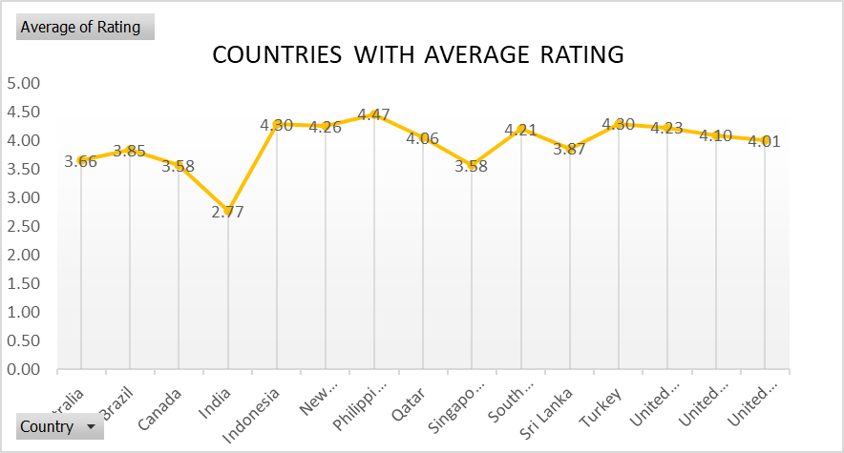
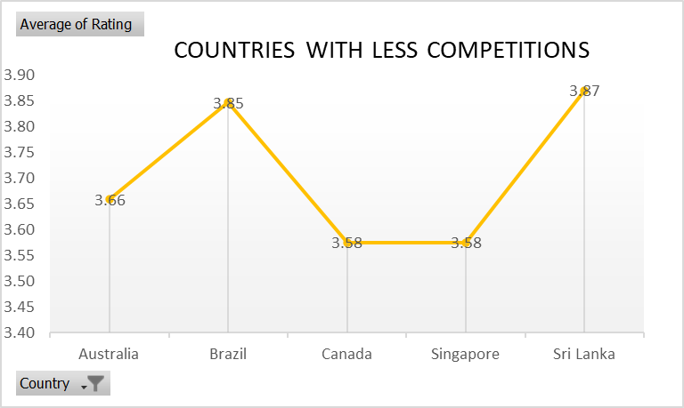
2. Recommendations
BASIS FOR SELECTION
Less Competition
Ratings less than 4, meaning there is an opportunity to tap the market with selected cuisines and right pricing.
Countries Shortlist : AUSTRALIA,BRAZIL, CANADA, SINGAPORE, SRI LANKA.

Slide 13
2.Shortlisted States/Cities within Suggested Counties
AUSTRALIA
1.Armidale,
2.Balingup,
3.Dicky Beach,
4.Flaxton,
5.Lorn,
6.Macedon,
7. Penola ,
8.Victor Harbor
BRAZIL
Sí£o Paulo
Brasí_lia
SINGAPORE
1. Singapore
CANADA
1.Consort,
2.Yorkton
SRI LANKA
1. Colombo

Slide 14
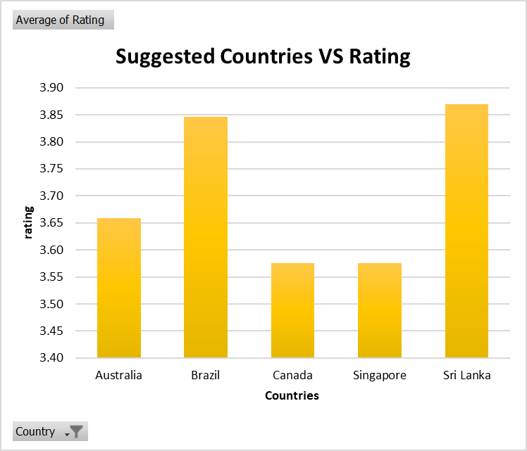
3.Average Rating vs Suggested Counties
There is an immense opportunity to increase the count of restaurant as the ratings are between 3 and 4.
If we provide best quality food across high rated cuisines, we can tap these markets and side by side make them profitable as well.

Slide 15
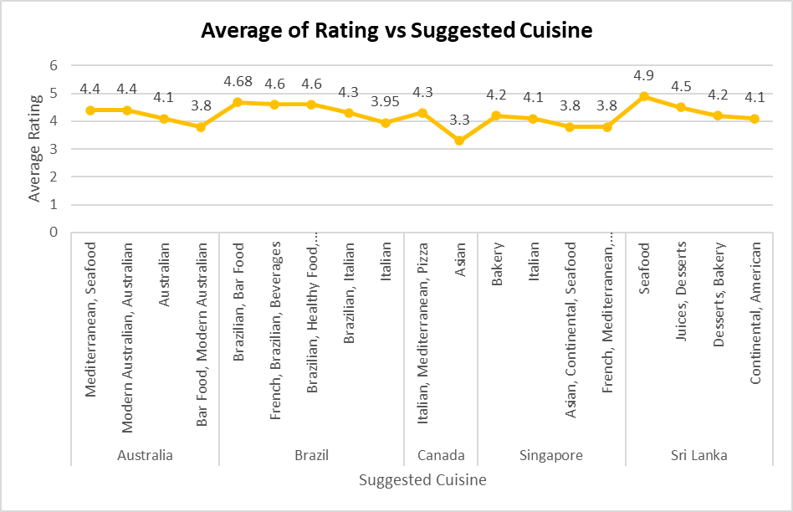
4.Cuisine Analysis
Following cuisines are high rated ones in the suggested countries.
Meaning we cannot go wrong if we tap a less competitive market with these cuisines as it is most likely to take off.

Slide 16
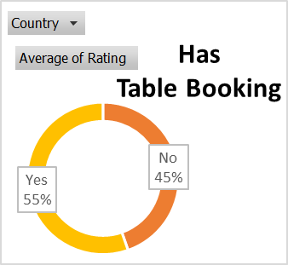
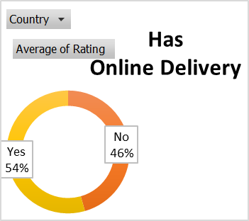
5.Online Delivery VS Table Bookings
Suggested countries do not have online Delivery and Table Booking.
Solving the problem of easily ordering online and giving convenience of service by allowing the customers to book a Table in advance may be seen as First Mover Advantage.

Slide 17
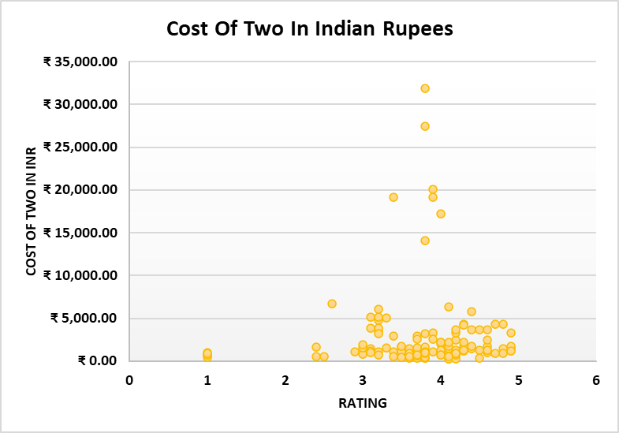
5.Correlation between Cost of Cuisines and Ratings
R^2=0.03153073
Positive correlation
A positive correlation is evident when two variables move in the same direction.
So we can say that cost of cuisines and rating of cuisine are two variables that change together in the same direction.
Which means if we increase the Cost of cuisine it will increase rating as well.

Slide 18
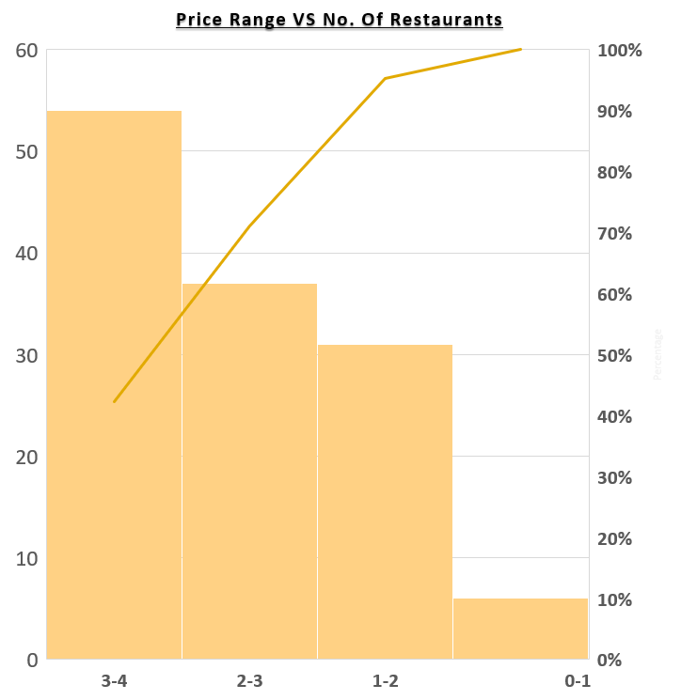
7.Restaurants in Different Price range
To understand the distribution of the number of restaurants of different price ranges in all the countries.
Used a Histogram with the trend line to illustrate the Price Range Distribution.

Slide 19
8.Key Finding
•Identified countries with potential for new restaurant openings based on low competition and favorable ratings.
•Recommended focusing on local cuisines while considering market preferences for menu planning.
•Analyzed the distribution of restaurants across different price ranges to understand market dynamics.
•Explored the impact of factors like online delivery and table bookings on customer satisfaction and market share.
•Investigated the correlation between cuisine rates and customer ratings to optimize profitability.

Slide 20
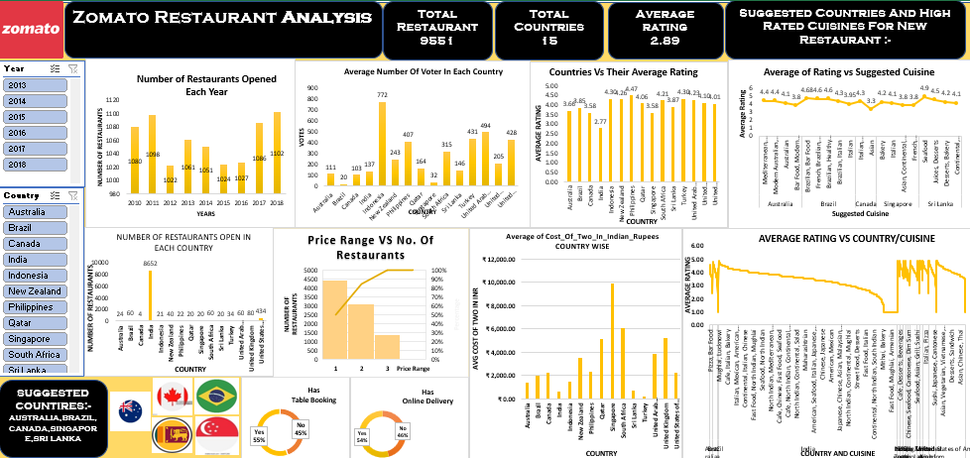
9.DASHBOARD

Slide 21
10.CONCLUSION
• Through meticulous data analysis, we've identified promising opportunities for expanding Zomato's presence.
• The selected countries and cities offer a balance of lower competition and favorable customer ratings.
• Emphasizing local cuisines while considering market preferences can enhance the success of new restaurants.
• Insights into online delivery, table bookings, and pricing dynamics provide valuable guidance for strategic decisions.
• Continual monitoring and adaptation based on customer feedback and market trends are crucial for sustained growth.

Slide 22
Thank You

